Slide 1


GSI 2021 Analysis
run 4306 (Minimum Bias)
¹⁶O 400 MeV/u on 5 mm C target
TW
MSD
BM
VTX
SC
CALO
TGT
1

Slide 2
GSI 2021 Analysis
run 4306 (Minimum Bias)
¹⁶O 400 MeV/u on 5 mm C target
TW
MSD
BM
VTX
SC
CALO
TGT
GLB tracking conditions:
  Events where there is more than 1 BM track are rejected
  Vertex matches with BM track
  4 points (VT) + 1 (TW)
1

Slide 3
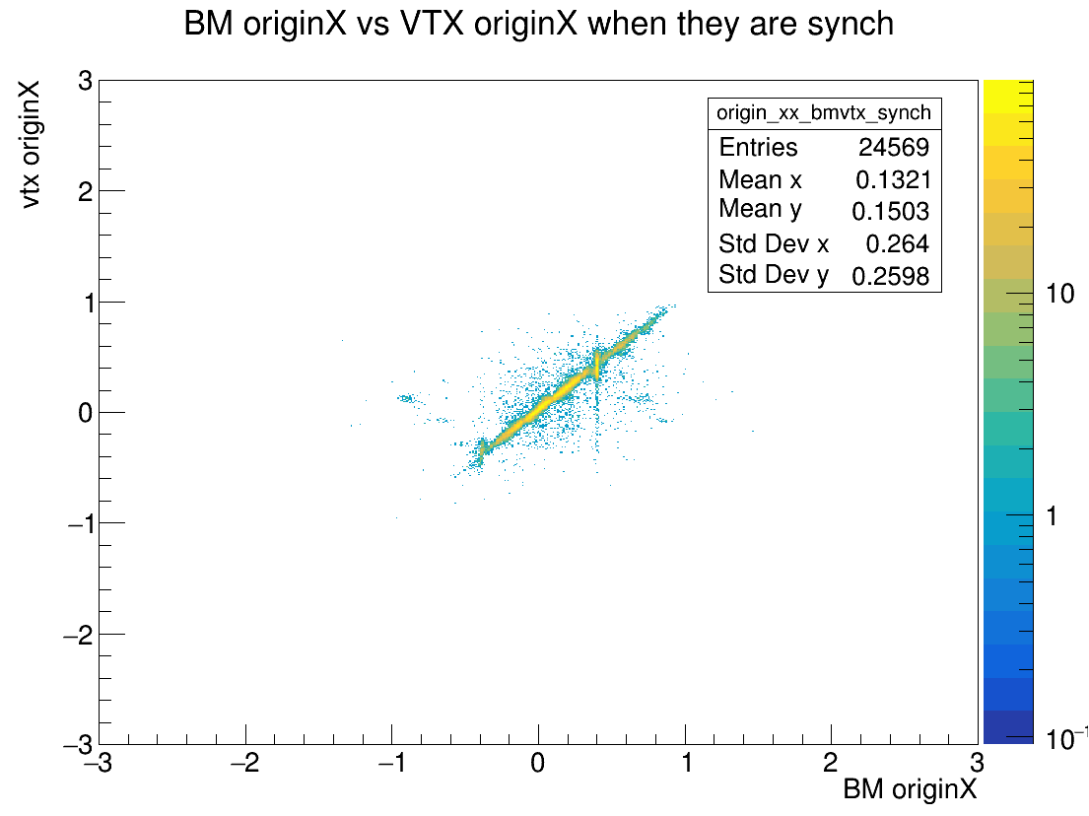
Synchronization
run 4306 (Minimum Bias)
Vertex (online) synchronization for all the events

Slide 4
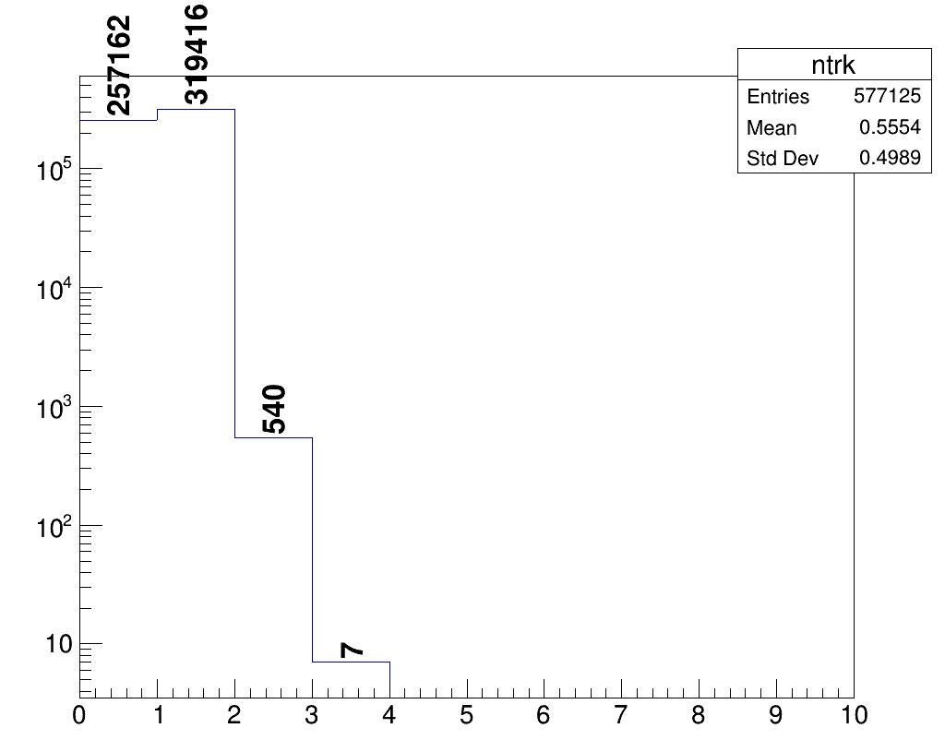
Global Track reconstruction
counts
45% of events are not reconstructed
  Is it a problem of alignment?
  Is it connected to the spill of the
  beam?
N tracks

Slide 5
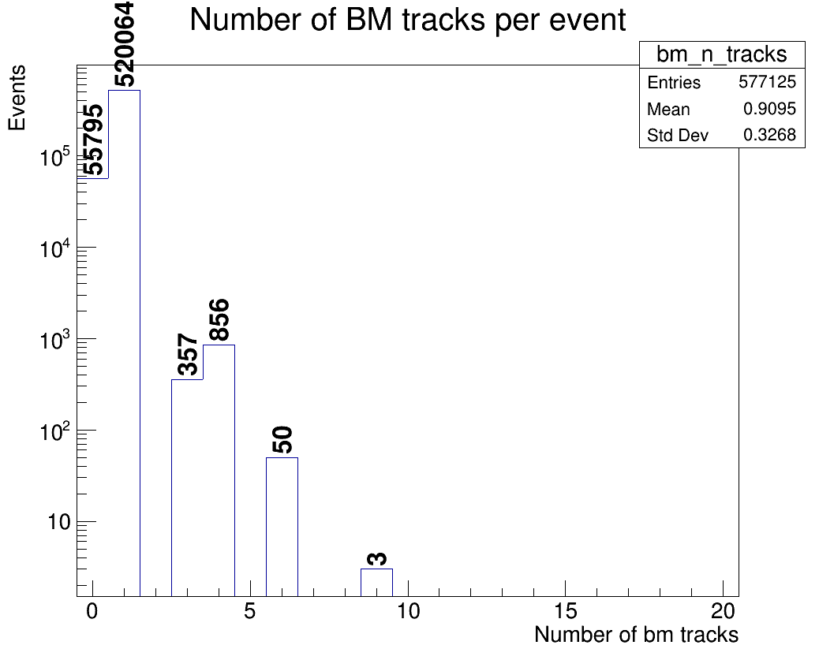
BM tracks
Nb: some events cannot be
reconstructed due to BM inefficiencies

Slide 6
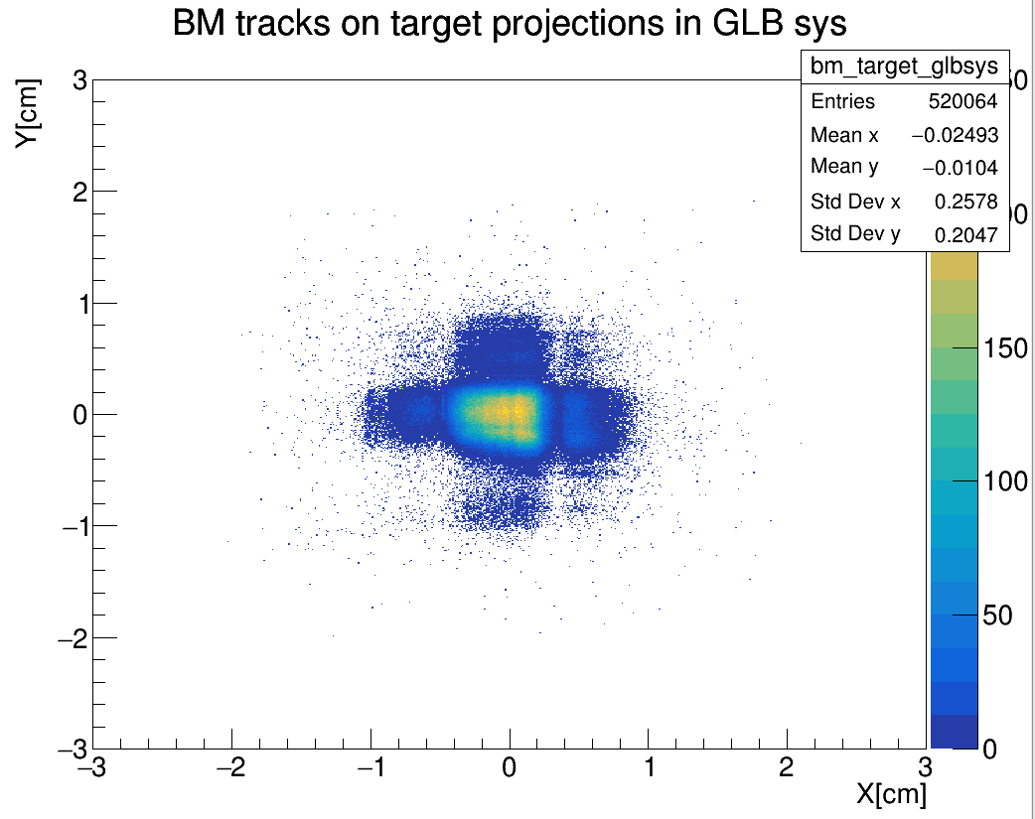
Alignment check, BM
N.B: the beam is centered in (0,0)

Slide 7
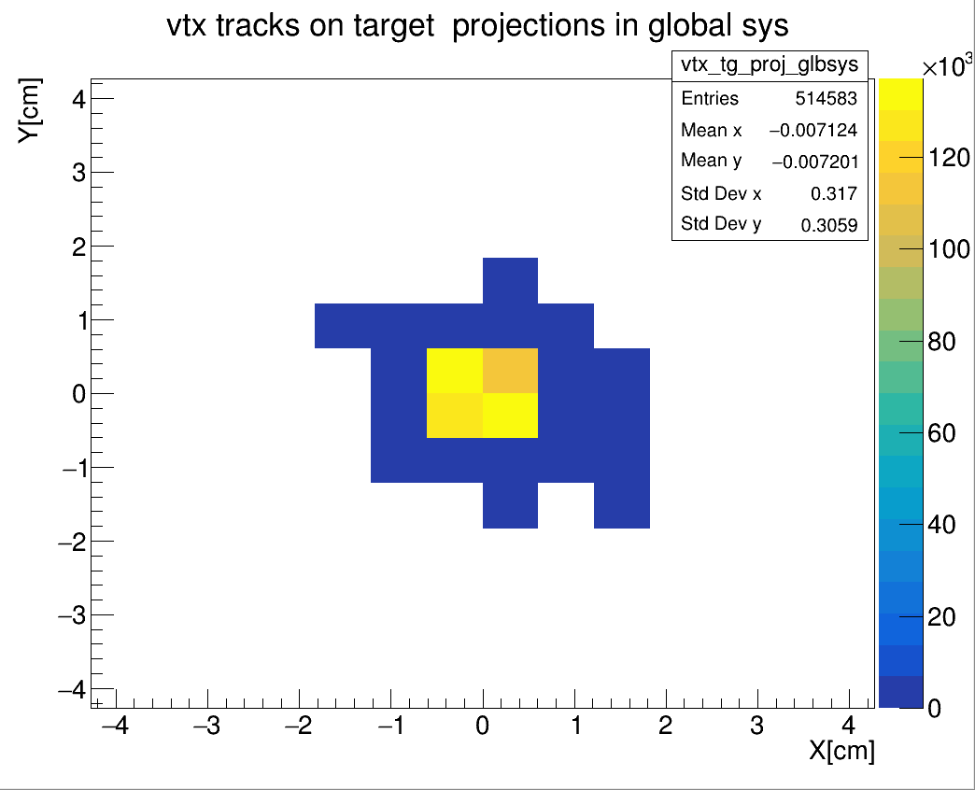
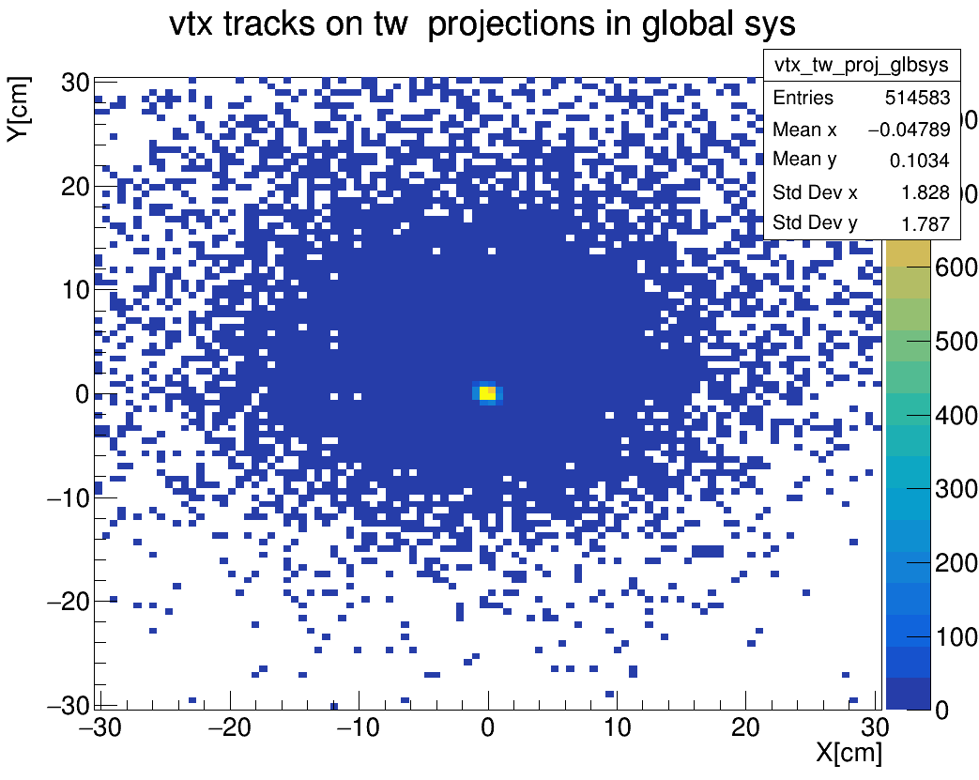
Alignment check, VTX

Slide 8
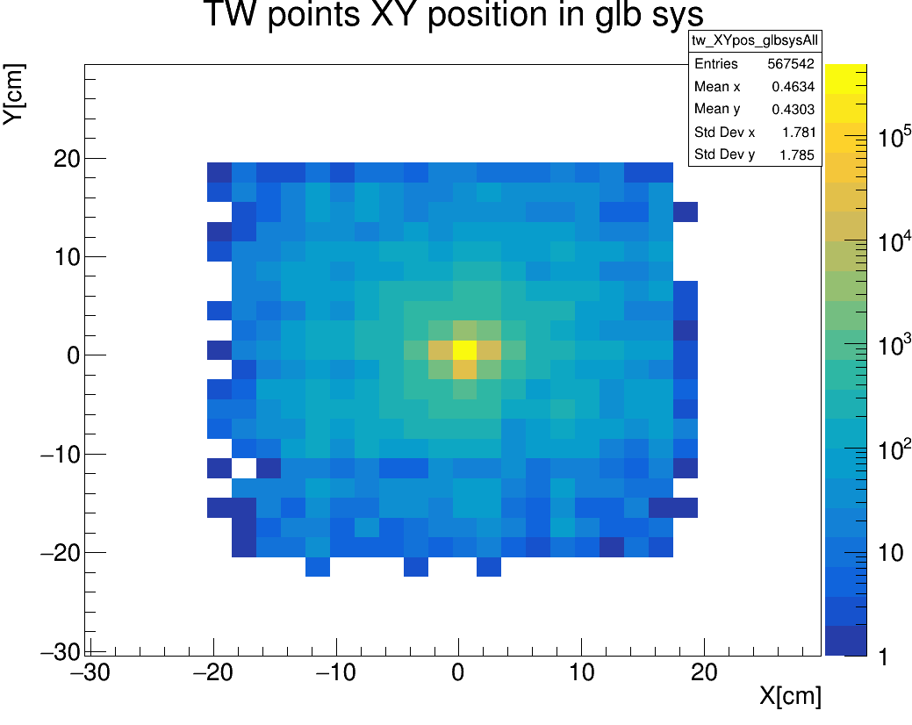
Alignment check, TW

Slide 9
Spill
Is it possible that some events are not reconstructed due to the shift of the beam?
Check position vs events to see if there are particular patterns
Compare detector tracks of reco vs unreco events

Slide 10
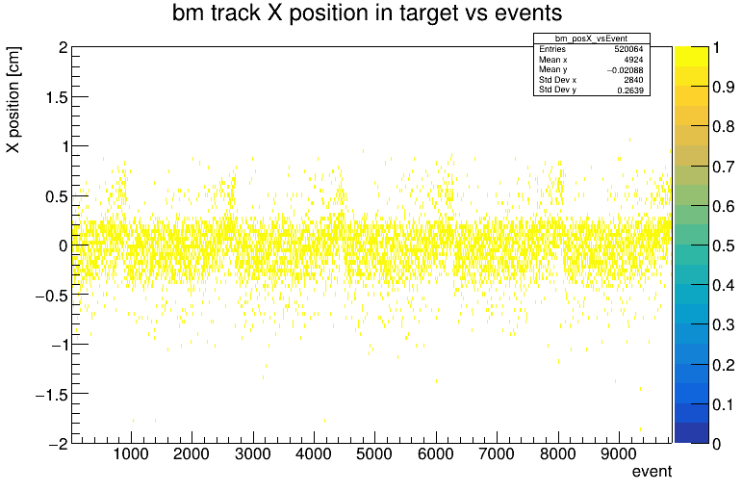
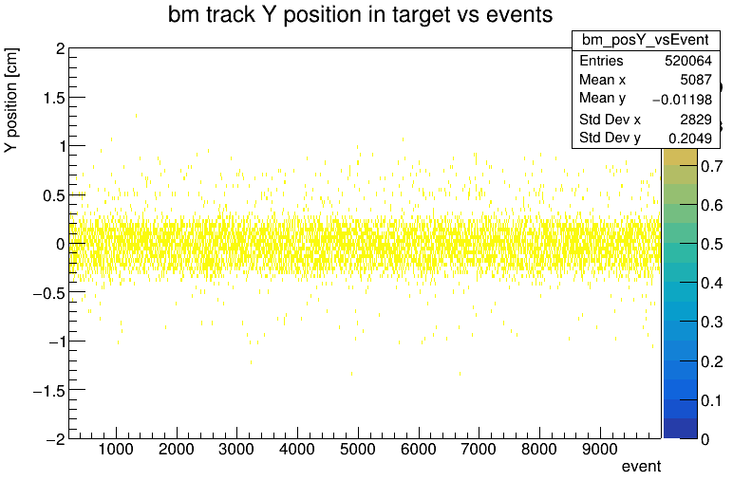
Spill, BM X Y position

Slide 11
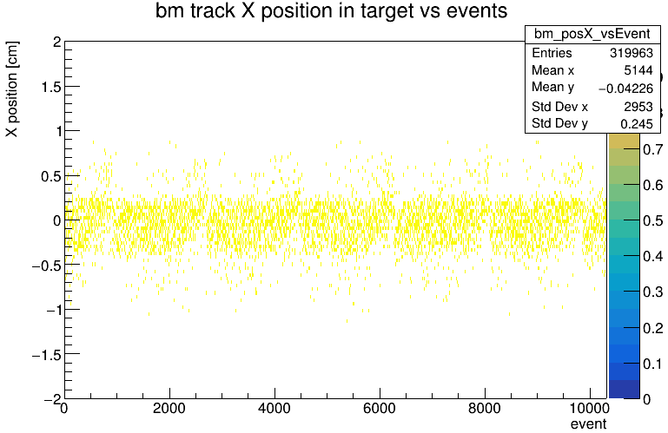
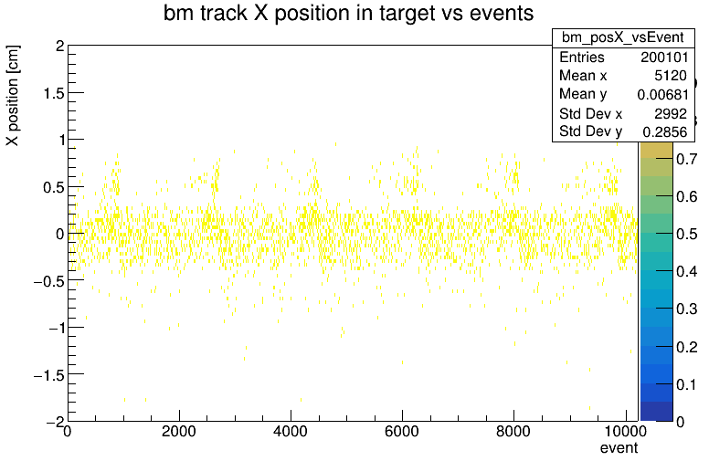
Spill, BM X position
Reco events UnReco events

Slide 12
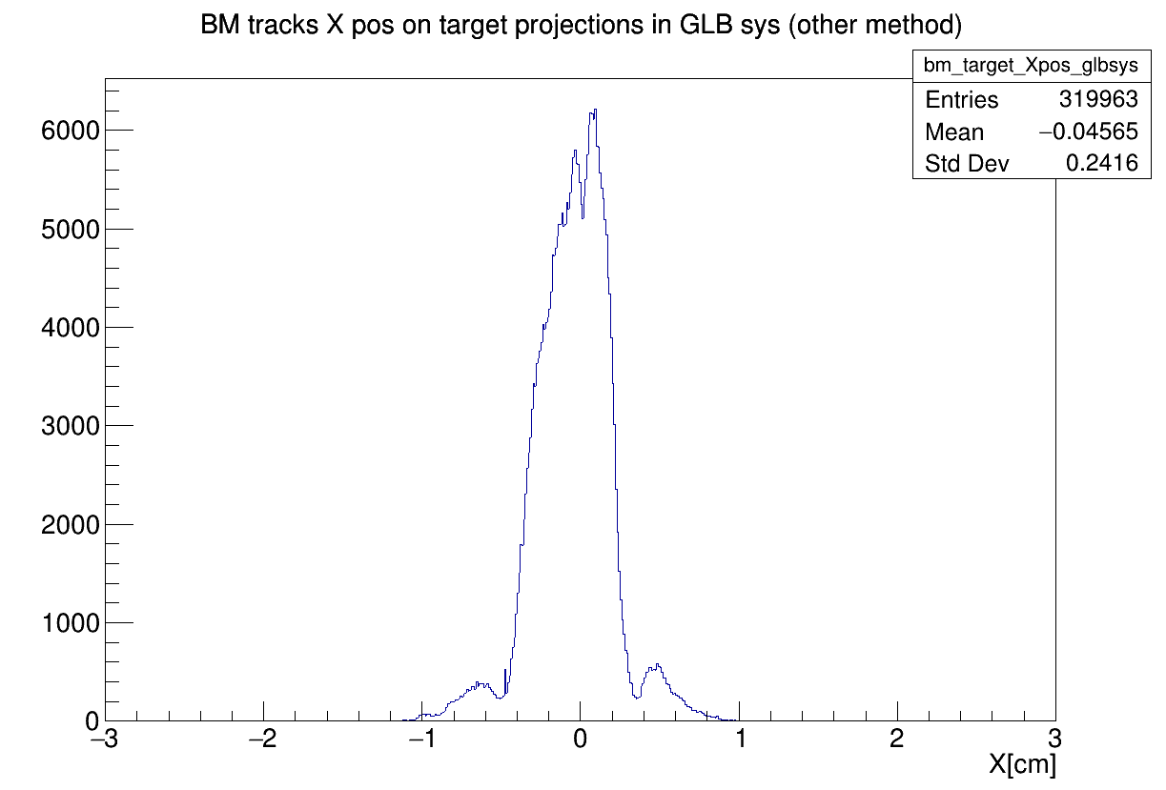
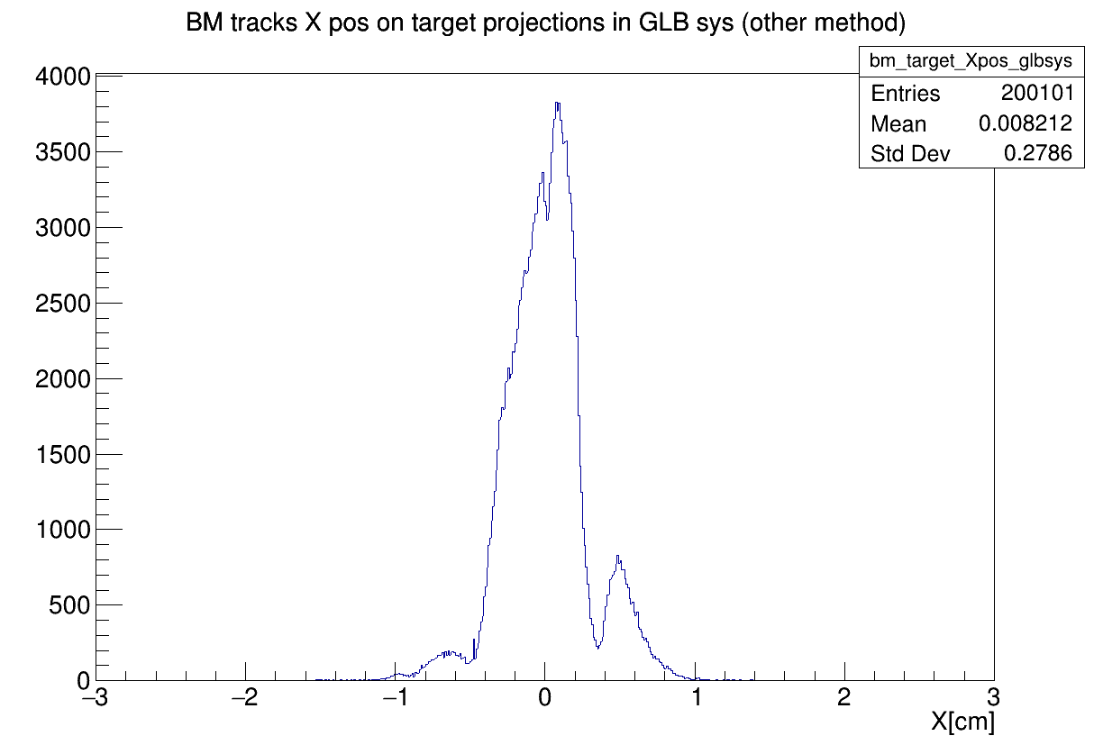
Spill BM X position
Reco events UnReco events

Slide 13
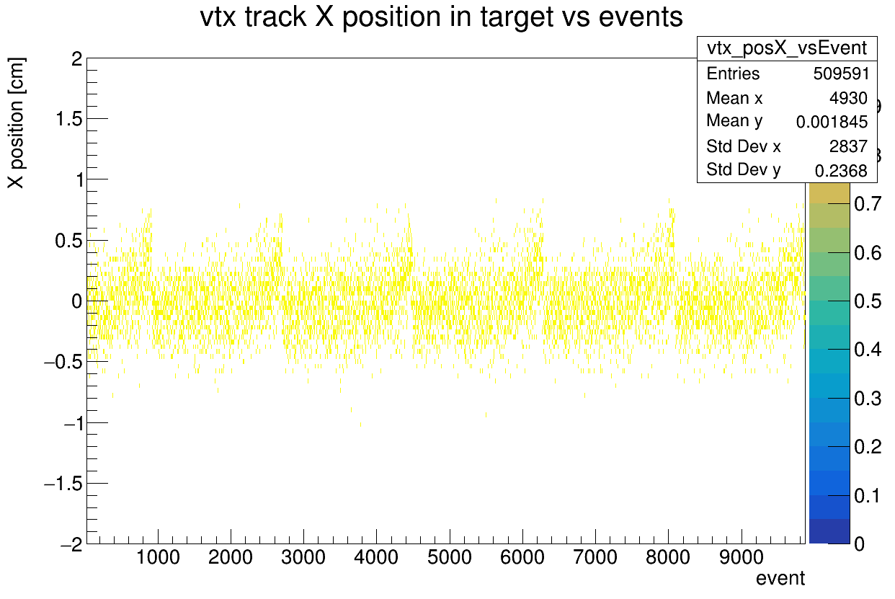
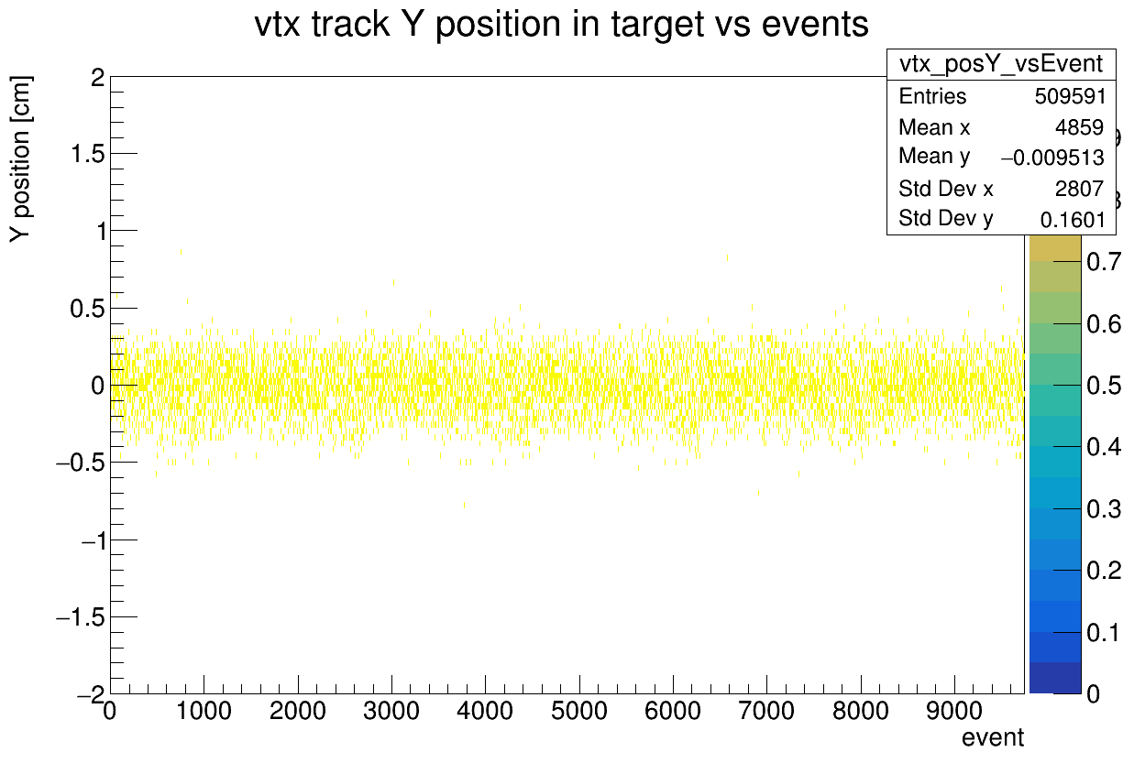
Spill, VT X Y position

Slide 14
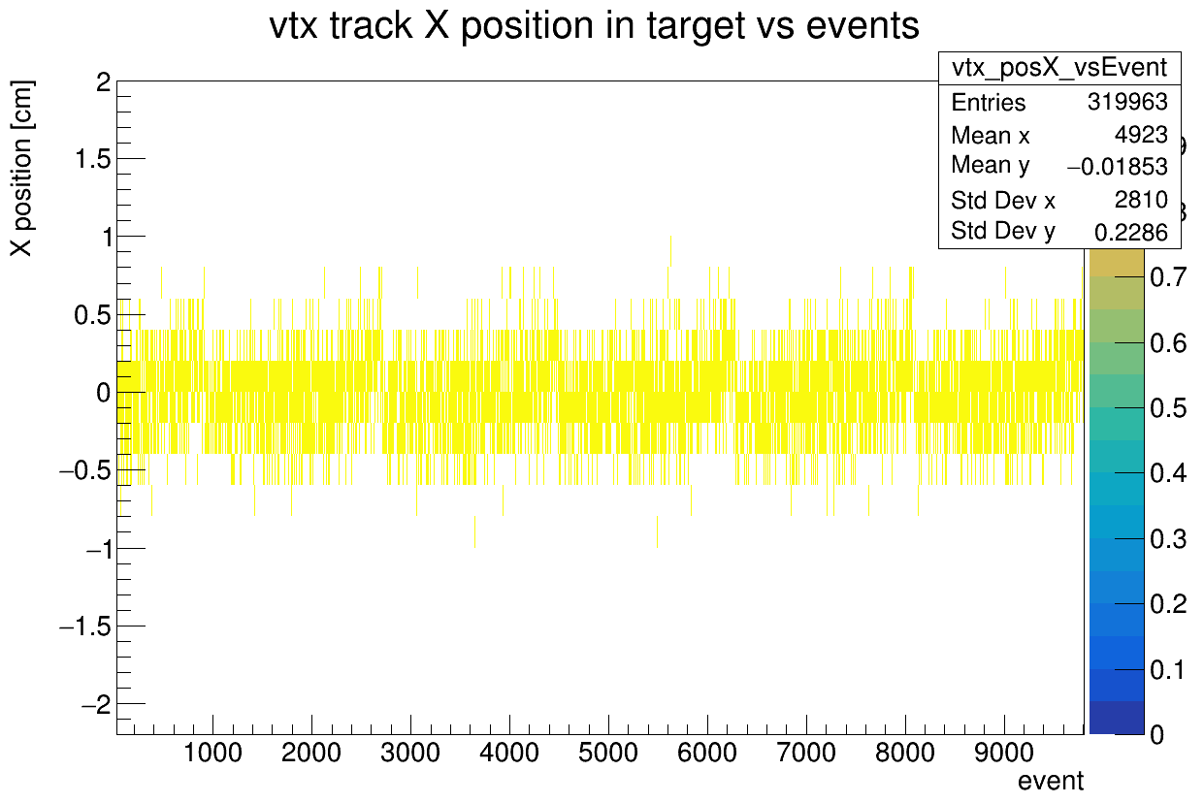

Spill, VT X position
Reco events UnReco events

Slide 15
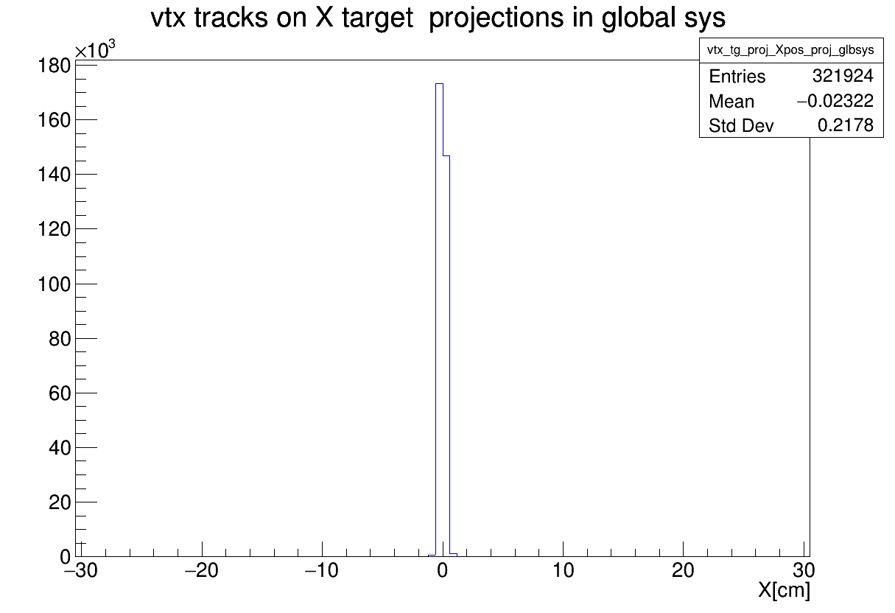
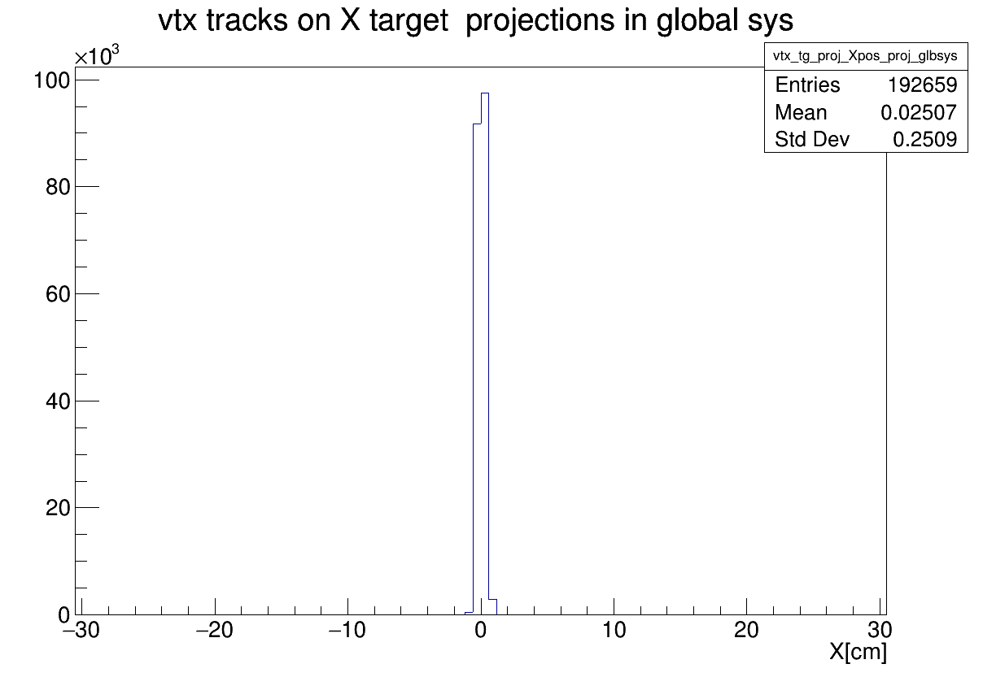
Reco events UnReco events

Slide 16
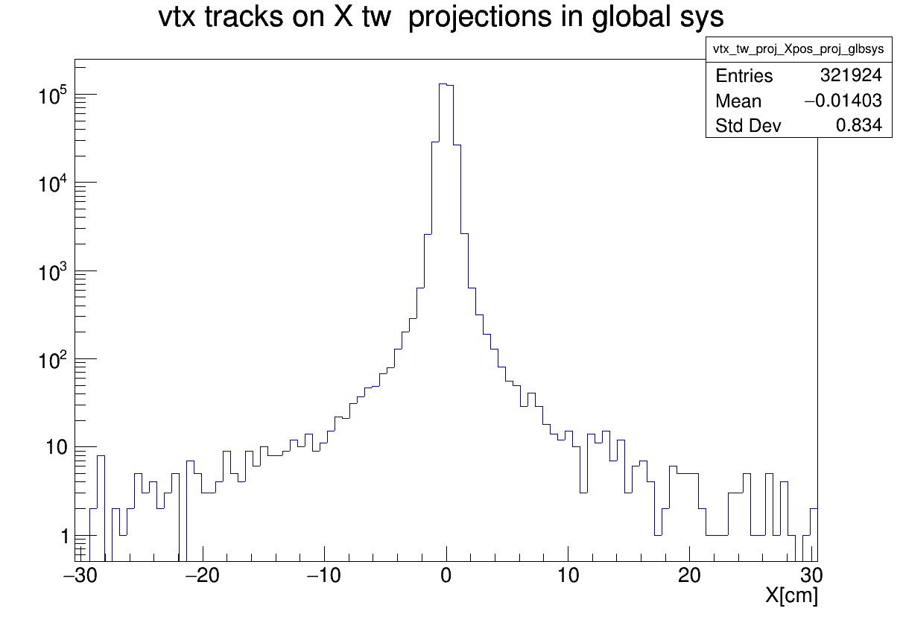
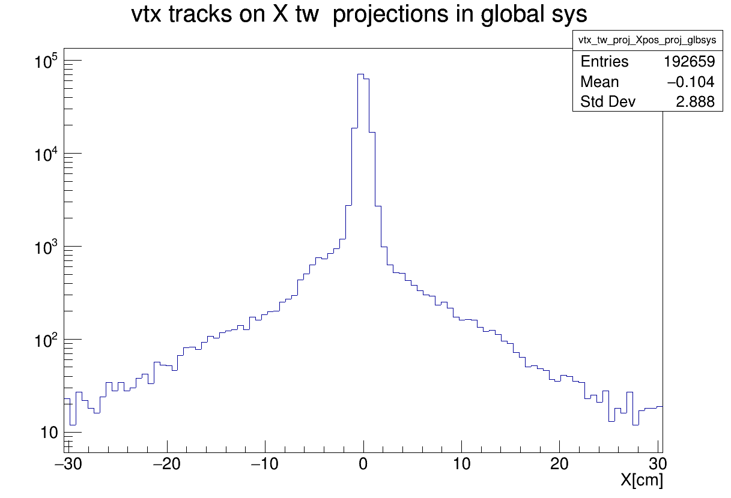
Reco events UnReco events

Slide 17
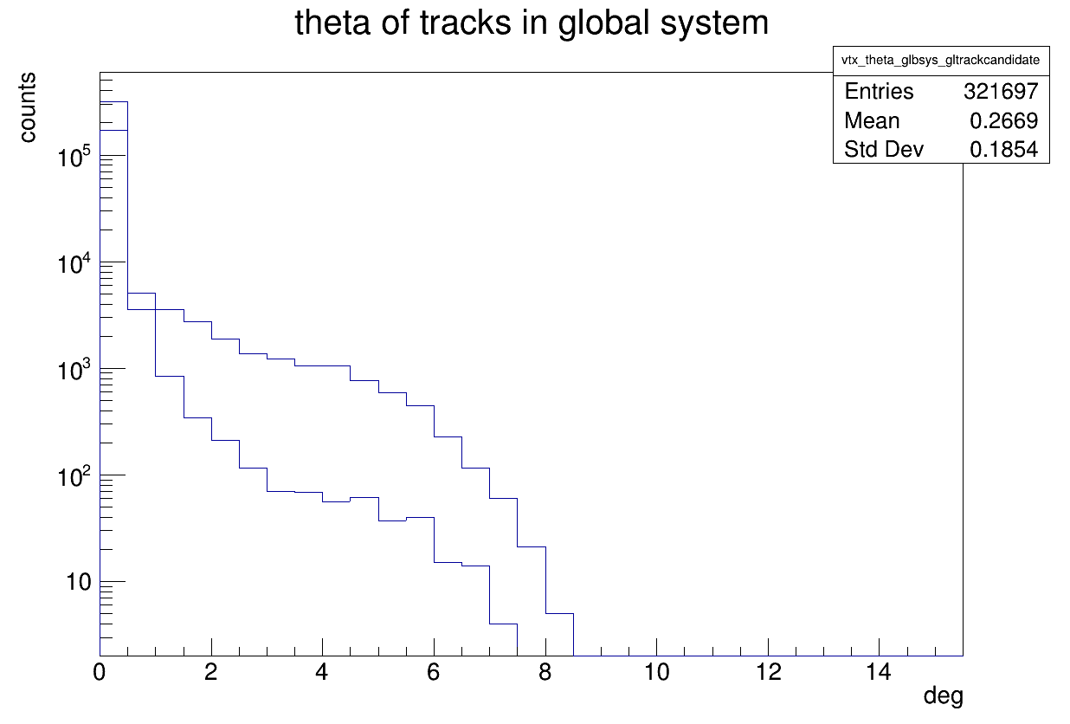
Theta of VT tracklets
Reco events
UnReco events

Slide 18
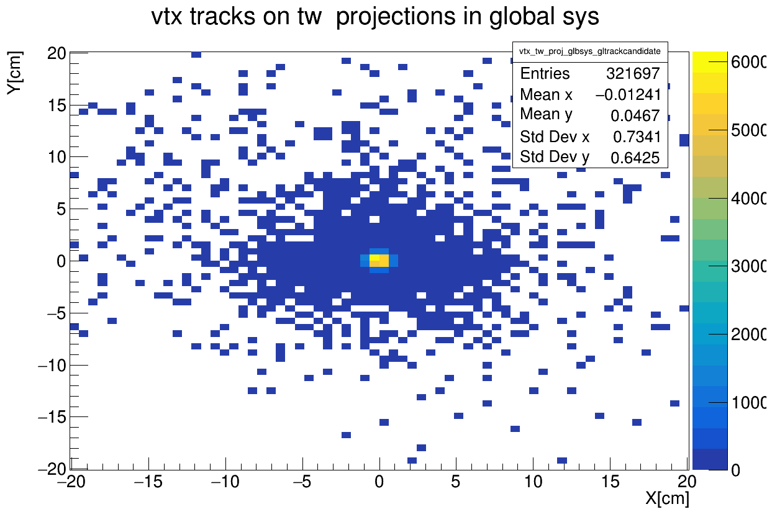
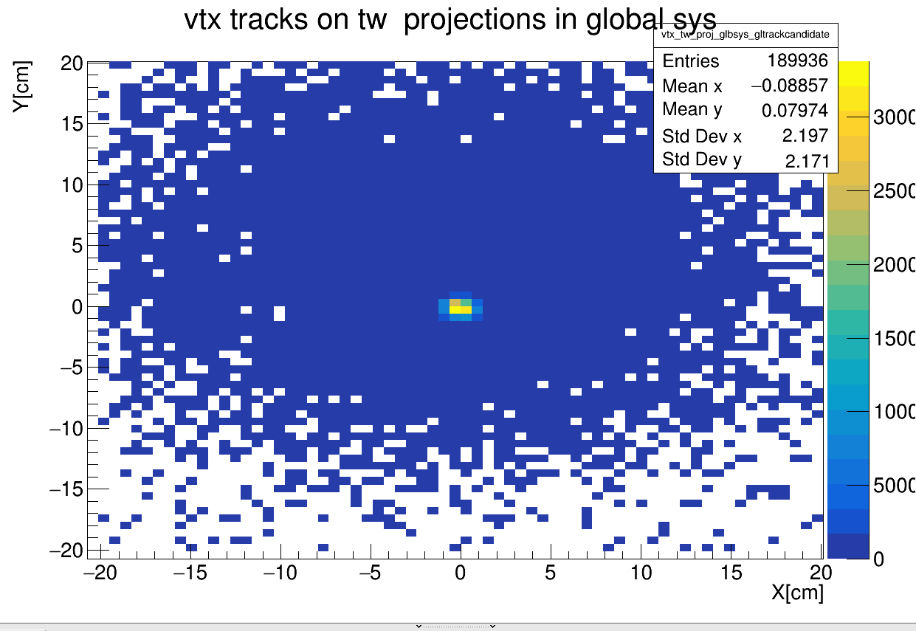
Vtx tracklets position
Reco events UnReco events

